Slide 1
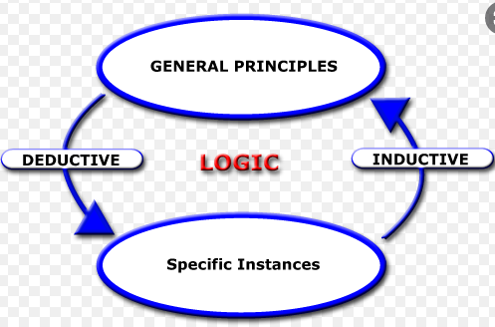
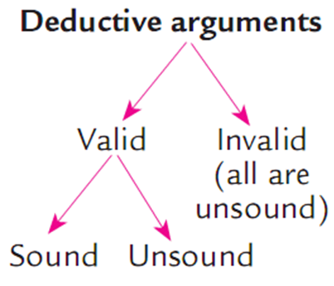
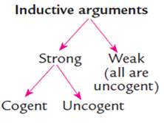
INDUCTIVE PATTERNS
Review of Chapter 3
DEDUCTIVE PATTERNS
1. Hypothetical syllogism
2. Categorical syllogism
3. Argument from definition
4. Argument from elimination
5. Argument based on mathematics
1. Inductive generalization
2. Predictive argument
3. Argument from authority
4. Causal argument
5. Statistical argument
6. Argument from analogy

Slide 2
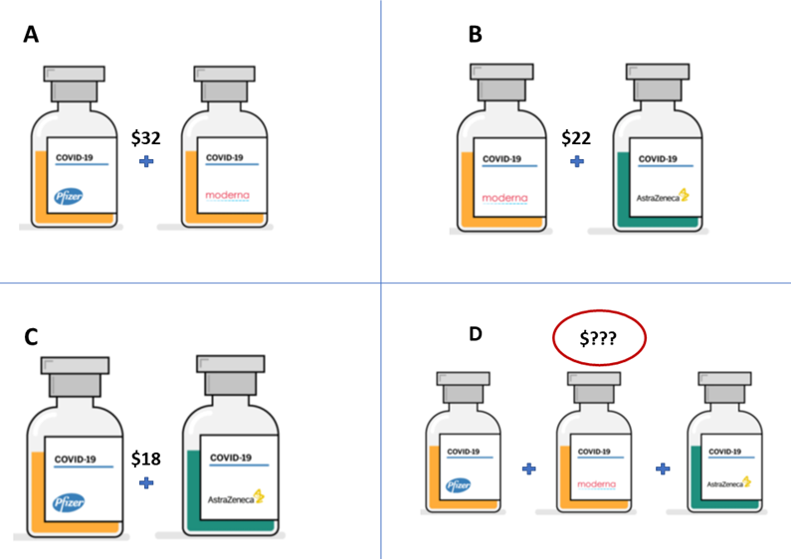
Review of Chapter 3
Present the most efficient way to find the answer. Which reasoning pattern do you apply?

Slide 3
Lengthy answer
Present the most efficient way to find the answer. Which reasoning pattern do you apply?
The total price of Pfizer and Moderna vaccine is $32
The total price of Moderna and AstraZeneca vaccine is $22
The total price of Pfizer and AstraZeneca vaccine is $18
x: the price of Pfizer
y: the price of Moderna
z: the price of AstraZeneca
x + y = 32
y + z = 22
x + z = 18
=> x= 14, y= 18, z= 4
Therefore, the price of Pfizer, Moderna and AstraZeneca respectively are $14, $18 and $4
The total price of 3 kinds of vaccine is: x + y + z = $36
Reasoning pattern: Deductive pattern
Type of argument: Argument based on Mathematics

Slide 4
Smart answer
Present the most efficient way to find the answer. Which reasoning pattern do you apply?
Write your answer here.
Picture A = $32 (specific premise)
Picture B = $22 (specific premise)
Picture C = $18 (specific premise)
Picture D = ??? (generalized premise)
From the picture, we can see in picture D that there are 1/2 types of COVID vaccine jar of picture A, B and C.
Therefore, picture D = (A+B+C)/2= 72/2 = 36 (in $) (conclusion)
⇨ Inductive argument

Slide 5
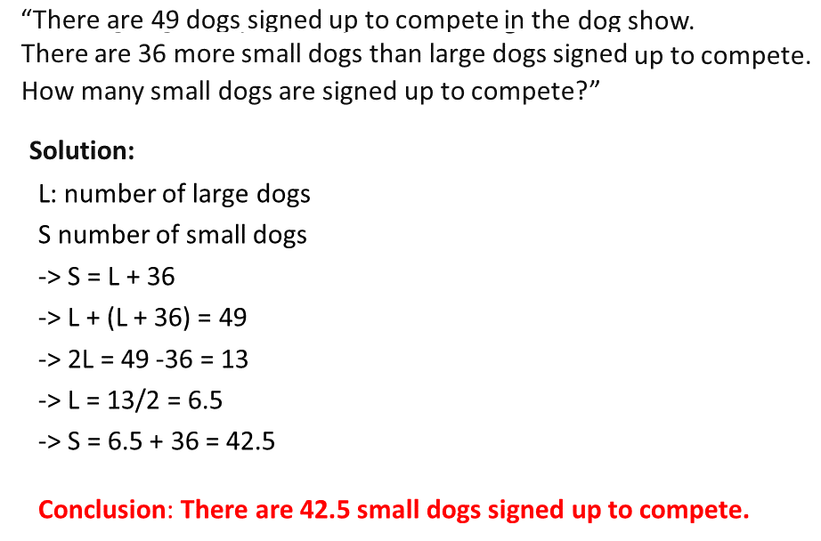
Review of Chapter 3
Reasoning pattern:
Type of argument:
Valid or invalid? Explain
Sound or unsound? Explain

Slide 6
Answer
Reasoning pattern: Deductive argument
Type of argument: Argument based on mathematics
Valid or invalid? Explain: Valid because all the steps based on mathematics are very reasonable, and logical to find the solution.
Sound or unsound? Explain: Unsound because the number of dogs should be a positive integer, meanwhile, the result in this circumstance is non-integer.

Slide 7
Assignment - Chapter 3

Slide 8

Task 1: Make an argument based on the clue
Premise 1: On a normal day, couples make FAs think that it is Valentine’s Day because of the couples’ romantic actions. (observation)
Premise 2: On Tết holiday or several different festive days, many couples act so romantically that FAs think that these days are also Valentine’s Day. (observation)
Conclusion: So, couples make FAs think that everyday is Valentine’s Day.
Argument pattern: Inductive generalization
Notes:
Bùi Ngọc Anh-IELSIU22332
Trần Minh Hạnh-IELSIU22324
Dương Kiều Ngân-IELSIU22333
Phan Đại Nghĩa-IELSIU22286
Đỗ Nhật Bảo Trân-IELSIU22319
Phạm Ngọc Vĩnh-IELSIU22273
Nguyễn Văn Vĩnh-EEACIU22174
Nguyễn Minh Quân-ITITIU22130

Slide 9
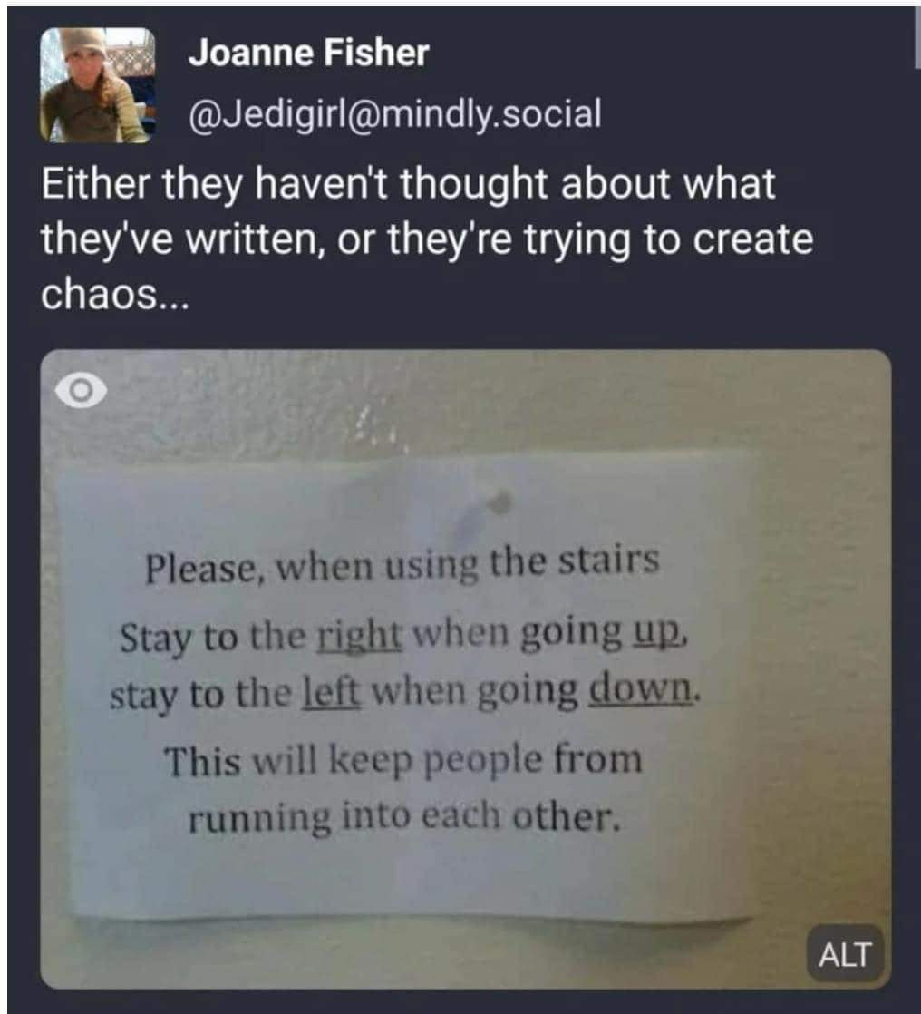
Task 2: Make an argument based on the clue
Argument pattern: Causal argument
Major premise: If going up, stay on the right side
Minor premise: If going down, stay on the left side (it’s actually still on the right side because it is in the opposite direction)
Conclusion: Collision would probably happen if everyone followed that instruction sheet
Argument pattern: Causal argument
Premise: If people stay to the right when going up and to the left when going down, they are actually on the same side. (observation)
Conclusion: As a result, collision or chaos would probably happen if everyone followed that instruction.
Notes:
Nguyễn Xuân Dung+ FAFBIU22036
Phan Châu Anh + FAFBIU22020
Lê Hồ Diệu Huyền + FAFBIU22246
Nguyễn Đức Trọng + FAFBIU22210
Ngô Ý Vy + BTBTIU22275
Nguyễn Hải Đăng + IELSIU22014
Nguyễn Minh Hùng + ITITIU22064

Slide 10
Task 2: Make an argument based on the clue (suggestion)
Premise 1: If people stay to the right when going up, this is to the left when going down.
Premise 2: If people stay to the left when going down, this is to the right when going up.
Conclusion: Therefore, it is logical to conclude that the instruction ask people to stay on the same side either if they go up or down.
Argument pattern: Hypothetical argument
Notes:
Nguyễn Xuân Dung+ FAFBIU22036
Phan Châu Anh + FAFBIU22020
Lê Hồ Diệu Huyền + FAFBIU22246
Nguyễn Đức Trọng + FAFBIU22210
Ngô Ý Vy + BTBTIU22275
Nguyễn Hải Đăng + IELSIU22014
Nguyễn Minh Hùng + ITITIU22064

Slide 11
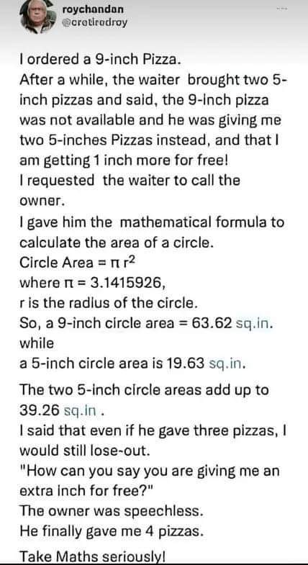
Task 3: Make an argument based on the clue
Premise + type:
+ Circle Area = pi r^2
where pi = 3.1415926 (minor)
+ I ordered a 9-inch Pizza... I requested the waiter to call the owner (major)
Conclusion: So, a 9-inch circle area = 63.62 sq.in, while a 5-inch circle area is 19.63 sq.in
Argument pattern: Argument based on Mathematics
Notes:
Phạm Thanh Thiên – ITITWE22133

Slide 12
Task 3: Make an argument based on the clue (suggestion)
General premise: Circle Area: A = πr²
(π = 3.1415926)
Specific premise 1: I ordered a 9-inch pizza. (r = 9 inches)
Sub-conclusion 1: So, a 9-inch circle area = 63.62 sq.in
Specific premise 2: The waiter gave me two 5-inch pizzas (r = 5 inches).
Sub-conclusion 2: So, a 5-inch circle areas = 19.63 sq.in
Sub-conclusion 3: three 5-inch circle areas = 19.63 sq.in *3 = 58.89 sq.in
Sub-conclusion 4: 58.89 sq.in < 63/62 sq.in
Main conclusion: I still lose out even if given three 5-inch pizzas.
Argument pattern: Argument based on mathematics
Notes:
Phạm Thanh Thiên – ITITWE22133

Slide 13

Task 4: Make an argument based on the clue
P1: You can get a discount 5% if you go with your current lover.
P2: You can get a discount 10% if you go with your ex-lover.
P3: You can get a discount 20% if you go with both your current lover and ex-lover.
Conclusion: So, chances are that the more lovers you go with, the higher the discount you will get.
Argument type: statistical argument

Slide 14
Task 4: Make an argument based on the clue
P1: You can get a discount 5% if you go with your current lover.
P2: You can get a discount 10% if you go with your ex-lover.
P3: You can get a discount 20% if you go with both your current lover and ex-lover.
Conclusion: So, it’s logical to infer that if you go with both lovers, you’ll get an additional 5% discount than if you go with them respectively.
Argument type: mathematical argument

Slide 15

Task 5: Make an argument based on the clue
P1: There is a sign with a child held sitting on the barrier to watch the crocodiles. (Observation 1)
P2: There is no circle thingy with the slash through it. (Observation 2)
Conclusion: So I guess it is acceptable to let children sit on the barrier for crocodile watch.
Assumption: Actions are only prohibited when there is a sign with circle thingy with a slash through it.
Argument pattern: causal argument
Notes:
1. Nguyễn Thị Phương Dung + MAMAIU22010 2. Dụng Xuân Trọng + MAMAIU22050 3. Hồ Trần Nguyễn Minh Trí + MAMAIU22063 4. Phạm Văn Nam + MAMAIU22100 5. Hoàng Anh Thư + MAMAIU22128 6. Hoàng Nguyễn Thảo Nhi + IELSIU22317 7. Trần Hoàng Thương + IELSIU22305 8. Võ Thục Minh Thư + IELSIU22310

Slide 16
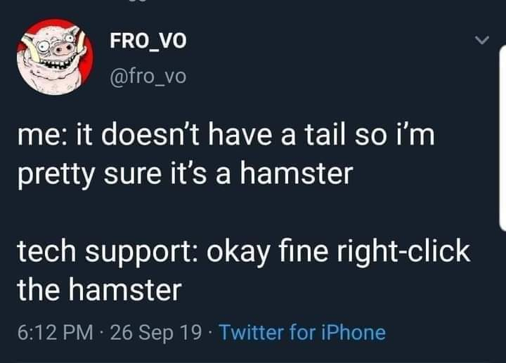
Task 6: Make an argument based on the clue
Argument: I believe that if the mouse doesn't have a tail, it will be a hamster. But then tech support said " okay fine, right click the hamster. "
Argument pattern:
argument by definition
P1: Hamsters have tails but are very short (even shorter than their feathers), so people often think they have no tails. (major permise/observation)
P2: it doesn't have a tail so i'm pretty sure it's a hamster. (minor permise/observation)
Conclusion: the computer mouse is hamster too.
Assumption: the computer mouse doesn't have a tail
Notes:
1. Nguyễn Thị Phương Dung + MAMAIU22010 2. Dụng Xuân Trọng + MAMAIU22050 3. Hồ Trần Nguyễn Minh Trí + MAMAIU22063 4. Phạm Văn Nam + MAMAIU22100 5. Hoàng Anh Thư + MAMAIU22128 6. Hoàng Nguyễn Thảo Nhi + IELSIU22317 7. Trần Hoàng Thương + IELSIU22305 8. Võ Thục Minh Thư + IELSIU22310

Slide 17
Task 6: Make an argument based on the clue (suggestions)
P1: A hamster is an animal which does not have a tail. (major premise)
P2: It (computer item) does not have a tail. (minor)
Conclusion: Therefore, it is a hamster.
Argument pattern: argument from definition
P1: A mouse has a long tail while a hamster has a very short tail. (observation)
P2: It (computer item) doesn’t have a tail. (observation)
Conclusion: So I’m pretty sure it’s more like a hamster than like a mouse.
Argument pattern: argument from analogy
Notes:
1. Nguyễn Thị Phương Dung + MAMAIU22010 2. Dụng Xuân Trọng + MAMAIU22050 3. Hồ Trần Nguyễn Minh Trí + MAMAIU22063 4. Phạm Văn Nam + MAMAIU22100 5. Hoàng Anh Thư + MAMAIU22128 6. Hoàng Nguyễn Thảo Nhi + IELSIU22317 7. Trần Hoàng Thương + IELSIU22305 8. Võ Thục Minh Thư + IELSIU22310

Slide 18
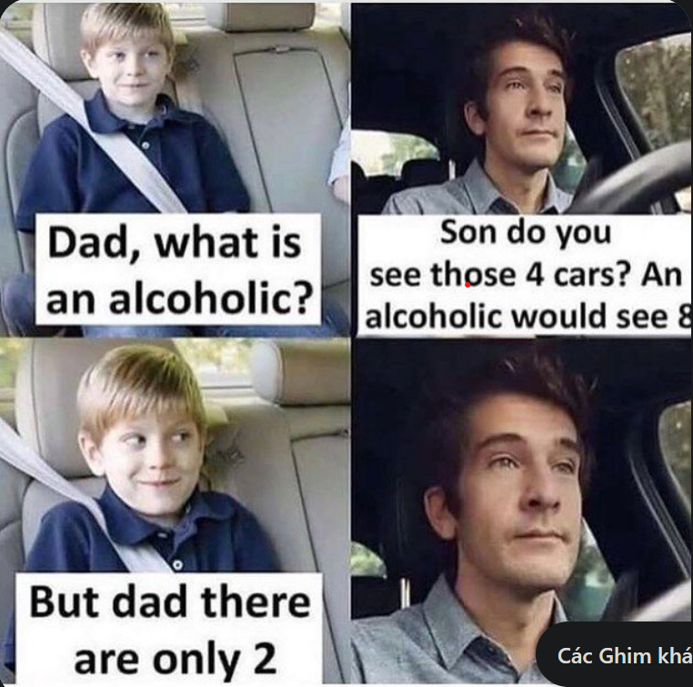
Task 7: Make an argument based on YOUR clue
Premises:
P1: An alcoholic will look double everything
(major premise).
P2: Dad looks 4 cars but there are only 2 cars
(observation).
Conclusion: Dad is an alcoholic.
Argument pattern: Argument from definition
Categorical argument:
Major premise: All alcoholics see things being doubled.
Minor premise: A dad points out four cars to his son while there are only two cars.
Conclusion: It is logical to infer that the dad is an alcoholic.
Notes:
1. Nguyễn Thị Phương Dung + MAMAIU22010 2. Dụng Xuân Trọng + MAMAIU22050 3. Hồ Trần Nguyễn Minh Trí + MAMAIU22063 4. Phạm Văn Nam + MAMAIU22100 5. Hoàng Anh Thư + MAMAIU22128 6. Hoàng Nguyễn Thảo Nhi + IELSIU22317 7. Trần Hoàng Thương + IELSIU22305 8. Võ Thục Minh Thư + IELSIU22310

Slide 19
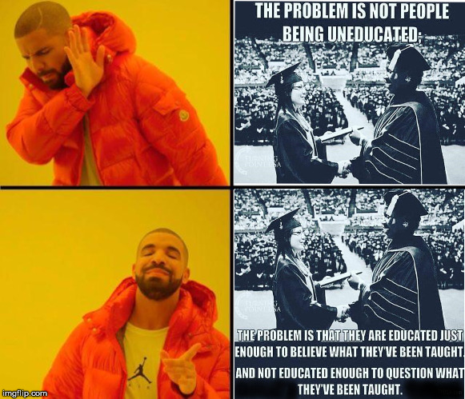
Task 7: Make an argument based on YOUR clue
Premises: People who are educated just enough to believe what they’re been taught is more dangerous than people who are uneducated.
Conclusion: Therefore, the educated just enough to believe what they’re been taught is more serious than the uneducated.
Assumption: People who are educated always believe in what they’re been taught, they take for granted without looking at all aspects. In addition, they aren’t educated enough to question what they’ve been taught.
Argument pattern: causal argument.
Premise 1: People who are educated just enough to believe what they’ve been taught are more dangerous than people who are uneducated. (observation)
Premise 2: People who are not educated enough to question what they’ve been taught are also more dangerous than people who are uneducated. (observation)
Conclusion: Therefore, both the educated just enough to believe and not enough to question what they have been taught are more problematic than the uneducated.
Notes:
Bùi Ngọc Anh-IELSIU22332
Trần Minh Hạnh-IELSIU22324
Dương Kiều Ngân-IELSIU22333
Phan Đại Nghĩa-IELSIU22286
Đỗ Nhật Bảo Trân-IELSIU22319
Phạm Ngọc Vĩnh-IELSIU22273
Nguyễn Văn Vĩnh-EEACIU22174
Nguyễn Minh Quân-ITITIU22130

Slide 20


Further practice 4
1
3
6
Strong
5
9
Strong
Strong
9
7
27
Weak
Strong
Strong
Notes:
Tip: Follow Rule of Three: Have at least three observations before making an inductive conclusion.

Slide 21
CHAPTERS 3 + 11 Inductive Reasoning
Notes:
In this lesson, we will not focus on theory. Instead, you’ll see how critical thinking is applied in actual cases of reasoning.

Slide 22
REVIEW: COMMON PATTERNS OF INDUCTIVE REASONING
1. Inductive generalization
2. Predictive argument
3. Argument from authority
4. Causal argument
5. Statistical argument
6. Argument from analogy

Slide 23


1. Inductive generalization (sampling argument)
Teacher: About 10 students in our class like Critical Thinking. Clearly, Critical Thinking is a favorite subject for all students in our class.
weak
Student: Sorry teacher, there are more than 100 students in our class. ☹
Teacher: It is likely that Critical Thinking is NOT a favorite subject for most students in our class. ☺
strong
Tips:
Consider the correlation between the sample and the population.
Be moderate with quantifiers like no, some, all, etc.
Notes:
Let’s suppose the teacher in the picture is me. My conclusion for all students in my class is based on a sample of only 10 students. A student of mine points out my reasoning mistake by comparing the small sample and a big population.
Advice: Do not hastily generalize (vơ đũa cả nắm); use moderate quantifiers instead to avoid oppositions or attacks.

Slide 24
1. Inductive generalization (sampling argument)
Task 1: Give an example with real numbers to point out the reasoning mistake.
A survey of Ryan’s class revealed that most students preferred chocolate to other flavors of ice cream. Chocolate must be the most popular flavor in the whole school.
Sample answer:
The argument assumes that Ryan’s class is a representative sample of the entire school. If Ryan’s class has only 10 students in a vanilla-loving school of 300, Ryan’s school cannot represent the entire school.
Tips:
Consider the correlation between the sample and the population.
Be moderate with quantifiers like no, some, all, etc.

Slide 25


2. Predictive argument (time shift argument)
The Covid-19 pandemic is still going on around the world. This nightmare will never disappear!
weak
Well, I’m not sure. Many countries have worked hard for effective vaccines and new virus variants seem less deadly.
The Covid-19 pandemic is still going on around the world. This nightmare will probably not disappear in a near future.
strong
Tip: Consider if there are other facts/possibilities that may cause a change and avoid strong confirmation.
Notes:
In life, things keep changing when time shifts but when we make predictive arguments, we tend to assume that things stay the same. To point out a reasoning mistake, you look for possible causes of change.

Slide 26



3. Argument from authority
Which speaker?
Industry 4.0 is a trendy concept now. We should apply big data in marketing for better profits.
Tip: Consider the appropriateness of the authority.
Notes:
Authority is the person/organization… that has power or expertise in a specific situation. In the example, businesswoman is the most suitable speaker about big data marketing, not the farmer or doctor.

Slide 27

3. Argument from authority
Task: Evaluate the conclusion
Premise: According to Tuổi Trẻ 24h, Vietnamese billionaire… is prohibited from going abroad!
Conclusion: So, this big shark will be arrested!
strong or weak
cogent or uncogent
Tip: Consider the relevance of the authority to the subject matter.
Notes:
https://tinmoi-247.com/tai-chinh/tung-tin-gia-ve-ty-phu-pham-nhat-vuong-phai-boi-thuong-neu-gay-thiet-hai-cho-thi-truong-chung-khoan-1183277

Slide 28

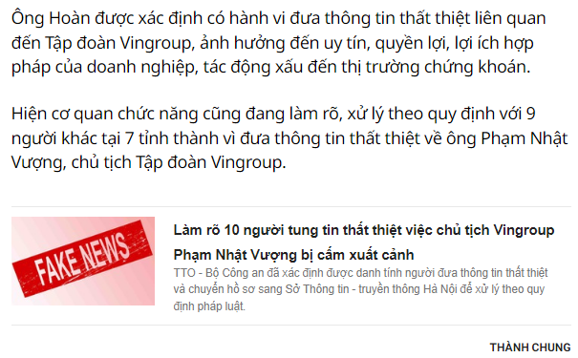
3. Argument from authority
Task: Evaluate the conclusion
P. According to Tuoitre Online, Tô Vĩ Hoàn was fined 7.5 million VND for his fake news about Vingroup CEO.
C. So, we should be careful about sources of news and should not share unverified news.
strong or weak
cogent or uncogent
Notes:
https://tuoitre.vn/phat-ong-to-vi-hoan-75-trieu-dong-vi-tung-tin-that-thiet-ve-chu-tich-vingroup-pham-nhat-vuong-20220711185111615.htm

Slide 29
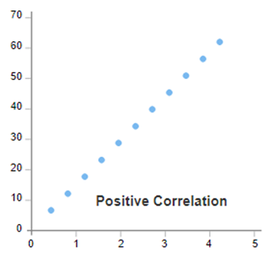

4. Causal argument
My critical thinking students attend class and stay in Teams till the end of the lesson. Clearly, they like to learn Critical Thinking.
weak
Honestly, we just log in Teams then play games in our laptop.
My critical thinking students attend class and stay in Teams till the end of the lesson. So I assume they possibly like to learn Critical Thinking.
strong
Tips: When concluding from correlation, make sure to use appropriate induction indicators.

Slide 30
5. Statistical argument
Last year only 60% of the students at IU registered Critical Thinking. This year, 80% of IU students registered this course. Clearly, there are more Critical Thinking students at IU this year.
weak
If there were 800 total students last year (60% of 800 = 480). If there are only 500 students this year, then 80% of 500 is just 400.
Last year only 60% of the students at IU registered Critical Thinking. This year, 80% of IU students registered this course. So, it can be assumed that there are more Critical Thinking students at IU this year.
valid
Tip: The subject of the premise(s) (reference class) should be as much like the subject of the conclusion as possible.

Slide 31
6. Analogy argument
P1. RMIT Vietnam teaches in English, offers a variety of programs in technology, design, and enterprise, and it is a global university.
P2. VNU-HCM IU teaches in English, offers a variety of programs in science, engineering, economics, and language, and it is a public university.
C. So, it can be assumed that RMIT Vietnam and VNU-HCM IU are of different/same models.
Tip: Consider relevant similarities.

Slide 32

Another analogy argument
Task: Evaluate this argument.
Britt, 20 years old, got infected with the Covid-19 and he was tested negative after 20 days of home quarantine. Brown is also 20 years old and just got infected with the Covid-19. So Brown should stay home for a 20-day quarantine, too.
weak
Different virus variants change the lengths of quarantine.
Tip: Consider dissimilarities to avoid weak conclusions.

Slide 33
Review: Tips to achieve inductive strength
A. Give reasonable premises:
Large, representative samples
Firm evidence, varied possibilities
Appropriate, popular authority
Careful observation of possible causes
Consistent reference class
Relevant similarities
1. Inductive generalization
2. Predictive argument
3. Argument from authority
4. Causal argument
5. Statistical argument
6. Argument from analogy
B. Avoid extreme conclusions:
Do not use absolute words: ‘certainly’, ‘obviously’, ‘absolutely’…
→ Use ‘probably’, ‘likely’, ‘chances’…
Notes:
To make strong and cogent inductive arguments, we need reasonable premises and moderate conclusions.

Slide 34
APPLICATION
Critical reasoning in multiple choice questions
Some typical question types
Assumption
Weaken (refute the conclusion)
3. Strengthen (support the conclusion)

Slide 35
1. Assumption
Causal argument
Josh has twenty years of typing experience behind him; therefore, if you are looking for an efficient typist to enter your data into the new system, you need to look no further.
The speaker assumes that____.
A. Josh’s job profile is the best that the new employer is going to get B. Josh is an outstandingly fast and accurate typist C. Josh will fit well into the new office
D. Twenty years of practice ensures typing efficiency
The correct answer is (D).
Notes:
By identifying the assumption, we can evaluate if the argument is weak or strong. In this example, if Josh really has 20 years of regular typing, then the conclusion is strong. In contrast, if he works as a typist for 20 years but he types really little at work, then the conclusion about an ‘efficient typist’ is less persuasive.

Slide 36
2. Weaken
Argument from analogy
A scientist planted two groups of plants under identical conditions of light, temperature, and water. Every day he would play sound effects of thunderstorms to one of the groups of plants and sounds of city traffic to the other. The group to which he played thunderstorms all died within a few weeks, but the other group developed well during the experiment. He therefore concluded that the sound of city traffic is more effective for helping plants grow than is the sound of thunderstorms.
Which of the following, if true, would most seriously weaken the scientist’s conclusion?
(A)The scientist put different types of plants in each group.
(B) The light affecting the plants changed according to the time of day.
(C)The plants with city traffic sounds died several weeks after the experiment.
(D)The plants were all purchased at the same time.
The correct answer is (A).
Notes:
This question type points out the reasoning mistakes/flaws. This analogy gives all similarities between the two groups of plants, but the question needs a dissimilarity to weaken the conclusion.

Slide 37
3. Strengthen
Causal argument
A popular Internet service provider changed its billing system, charging customers per each connection to the system rather than per total hours connected. According to the company, under the new system, customers will spend more time connected to the Internet while paying the same or smaller amounts.
Which one of the following statements, if true, would most strengthen the conclusion of the company?
(A) Customers will be happier if the company’s Internet service is stable.
(B) Customers will drop because the company’s Internet service is poor.
(C) The more time spent online costs customers more money.
(D) The company’s employees also support the change in billing.
The correct answer is (A).
Notes:
This type of question asks you to give one more premise to make the conclusion stronger. In other words, strengthen questions agree with the conclusion.

Slide 38
MCQ PRACTICE
Identify the argument pattern and select the best answer.

Slide 39
Question 1
Argument from generalization
Photography is no longer an art form. Nowadays everyone has access to digital cameras that only need to be pointed at the subject in order to generate a perfect image.
The writer of the argument apparently assumes that
A. the selection of the subject is not an artistic factor in photography B. digital cameras will continue to improve in quality C. digital cameras can never go wrong D. photography with all other types of camera is an art form
The correct answer is
A
Notes:
Explanation: The conclusion is ‘Photography is no longer an art form’ because people simply point the camera at the subject and take a picture.
Answer A: This means the speaker assumes the subject itself is NOT a form of art.

Slide 40
Question 2
Causal argument
Recent studies have highlighted the harmful effects of additives in food (colors, preservatives, flavor enhancers etc.). There are no synthetic substances in the foods we produce at Munchon Foods – we use only natural ingredients. Hence you can be sure you are safeguarding your family’s health when you buy our products.
Which of the following, if true, would most weaken the conclusion of Munchon Foods?
A. Some synthetic substances are not harmful. B. Some natural substances found in foods can be harmful. C. Food without additives is unlikely to taste good. D. Without preservatives some foods could cause harm.
The correct answer is
B
Notes:
Explanation: ‘Weaken’ means you don’t agree with the conclusion and you point out a mistake in it.
This is a causal argument: According to the speaker, the cause of unsafe food are from harmful effects of additives. If you don’t agree that only natural ingredients make safe food, you point out another cause that these natural substances have harmful effects as well.
Answer B does that.

Slide 41
Question 3
Causal argument
A fruit known as amla in certain parts of Asia is an excellent source of vitamin C. A small quantity of the fruit added to salads provides almost all the daily requirement of this vitamin. However, the fruit is very sour. A new process designed to remove most of the sour taste will make the fruit acceptable to American tastes. We are therefore starting to grow this fruit for sale in the United States.
The argument above assumes all of the following except that
A. Americans generally won’t eat very sour foods B. the new process does not remove a significant part of the vitamin content C. there is a market for a new source of vitamin C D. The fruit can be used only in salads E. Apart from being sour there are no other objections to eating this fruit
The correct answer is
D
Notes:
Assumption A is from the premise that sourness of the fruit is removed before it is grown for sale in the U.S (conclusion).
Assumption B is from the premise that the fruit can provide almost all the daily vitamin requirement, so the producer tis trying it in a new market (the U.S). This may be a wrong assumption the process may also remove the vitamin. However, the question just asks us about finding ALL the assumptions to select the one that is NOT assumed (except).
Assumption C: The producer is targeting the U.S. for the product, so he/she assumes that it is a new market.
Assumption E: The producer just tries to solve the problem of sourness, so he/she assumes there are no other problems/complaints about this fruit.
Answer: D is not an assumption because the word ‘only’ is extreme: the speaker says the fruit is used in salads, but he/she does not exclude other uses of the fruit.

Slide 42
Question 4
Causal argument
Anton: I sold my house on an Internet site last year and was happy with the price. I got a speedy sale and the cost of advertising was low. I would advise you to avoid real estate agents.
Barbie: The real estate agent gets me the best price for my house because he gets a commission based on the selling price. Therefore, I will certainly use an agent rather than trying to sell the house on the Internet.
Which of the following strengthen Barbie’s opinion?
A. Houses of the same value often obtain a lower price when sold online. B. Very few houses are sold successfully via real estate agents. C. Nearly no buyers pay the agent to find them a cheap house.
D. Internet sites offer many add-on benefits besides net prices.
The correct answer is
A
Notes:
‘Strengthen’ means you agree with the conclusion and you provide more premises to make it stronger. Here, Barbie’s conclusion is she should use an agent, not selling on the Internet.
A strengthens the Barbie’s conclusion because selling on the Internet obtains a lower price.
B weakens Barbie’s conclusion because of Barbie’s low probability of success.
C weakens Barbie’s conclusion because Barbie cannot sell easily if there are nearly no buyers.
D weakens Barbie’s conclusion because selling on the Internet has more benefits.
Answer: A

Slide 43
Question 5
French cuisine is highly regarded all over the world. Yet in Paris there are more American restaurants selling burgers and fries (junk food) than there are in any other European capital city. Obviously the French are very fond of ‘junk food’.
Which of the following, if true, would most weaken the author’s conclusion?
A. There are also a larger number of Lebanese restaurants in Paris than in other European capital cities B. Very few French tourists eat in New York burger restaurants C. Junk food is actually has high nutritional value when eaten enough D. There are a large number of American tourists in Paris who eat at burger restaurants
D
The correct answer is
Notes:
‘Weaken’ means you do not agree with the conclusion: ‘French are very fond of junk food.’ In this causal argument, the speaker assumes that more American restaurants selling burgers and fries are found in Paris because more French like junk food (positive correlation)
Answer D: points out another cause of more American restaurants are found there: for American tourists, not for French.

Slide 44
A sample question in Quiz 1
"Don't make fast food your regular meal plans. Overeating fast food brings you weight and health problems."
Which of the following has the same argument pattern?
The national agency just penalized a poor quality restaurant in our city. This agency controls food safety. I’ll never eat at that restaurant again.
KFCs sell fast food to their regular customers, causing them weight and health problems. So, all fast food restaurants cause their regular customers weight and health problems.
Watching too much TV makes teenagers passive. Therefore, parents should control their children's entertainment habits.
All extreme fast food eaters are obese. All obese people have health problems. Therefore, all extreme fast food eaters have health problems.
causal argument
argument from authority
argument from generalization
causal argument
categorical syllogism

Slide 45
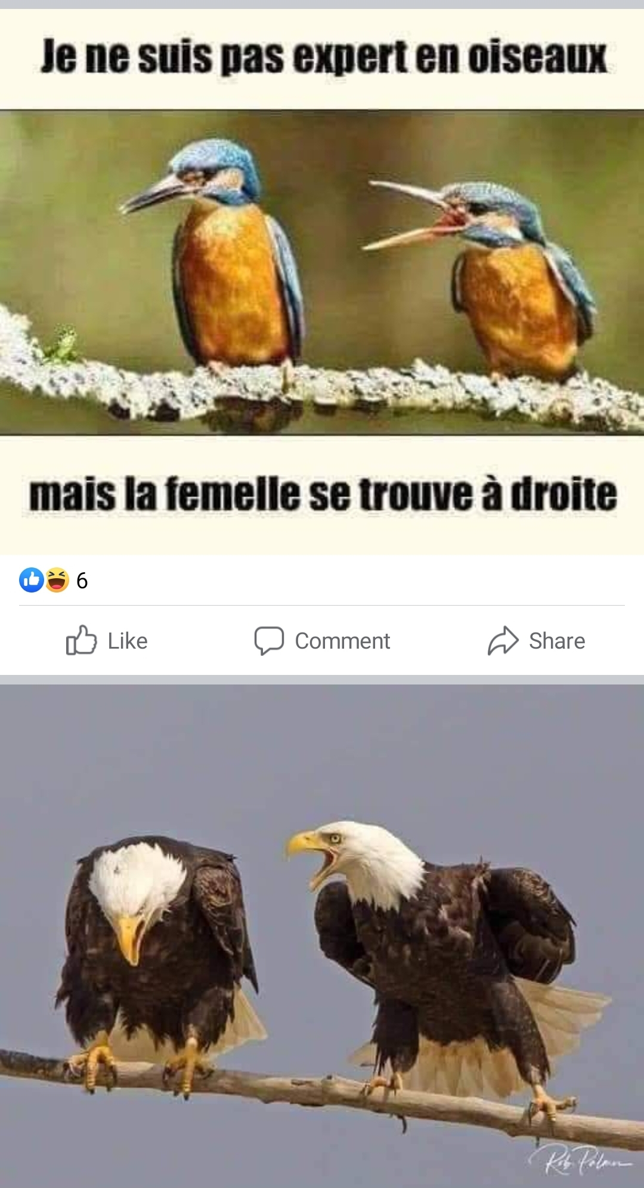
Sample question for Quiz 1
I’m not an expert on birds.
Question: Which of the following can be the writer’s assumption?
A. The bird on the left is a male.
B. Females are more verbally aggressive.
But the female is on the right.
C. All female birds are aggressive.
D. Females are more aggressive by nature.

Slide 46
Sample question for Quiz 1
I’m not an expert on birds.
Question: Which type of argument does the writer make?
A. Predictive argument
B. Argument from generalization
But the female is on the right.
C. Argument from definition
D. Argument from elimination
General premise: In any mating pair, the female is more verbally aggressive than the male.
Minor premise: The bird on the right is more verbally aggressive.
Conclusion: So, it logically follows that the bird on the right is the female.

Slide 47
Evaluate these inductive arguments with critical questions.
FURTHER APPLICATION

Slide 48
1. Inductive generalization
Students in University X was going to vote for a student president and the election organizers held a survey before the election day. 55% of the surveyed students from the 1st, 2nd, 3rd and 4th years said that they would vote for Peter Smith and 45% would vote for the other competitor. Based on the survey results, the election organizers concluded that Peter Smith would win the election.
Hint: Check sample size and representation.
Sample critical questions:
What is the ratio of surveyed students/voting students?
Is University X a four-year or six-year (medical) university?
Notes:
Question 1 checks sample size.
Question 2 checks representation.

Slide 49
2. Predictive argument
“AZ company began making loss two years ago. There have not been any signs of profits until now. The management will declare bankruptcy in the next 2 years.”
Hint: Point out possible changes in the future.
Sample critical questions:
Are the management in the last two years and the next two years the same?
Has the economy been in a crisis and are there any signs of recovery now?
Will there be any governmental support for declining businesses?
49

Slide 50
3. Argument from authority
“In order to raise the levels of students’ English skills, all schools must adopt the “Back to Basics” English program. According to ABC News Agency, the Ministry of Education developed this program to improve English skills among students nationwide.”
Hint: Question the reliability and appropriateness of the authority
Is ABC News Agency a trustworthy source of information?
Is the Ministry of Education always reliable with its leadership?
50

Slide 51
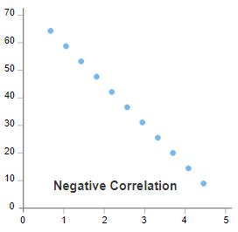
3. Causal argument
“Parents of young children are becoming increasingly concerned about how violence on television influences a child’s behavior and attitudes. During the past year, the ratings for Real Crime, one of the most popular prime-time shows, have steadily declined. Therefore, in order to boost our prime-time ratings, we should replace Real Crime with a comedy show for children.”
Hint: Question the correlation of the two factors
Do children watch Real Crime?
Does Real Crime really show violence?
Have the ratings declined because of other factors like the changed hours or increased fee, etc.?
Will children watch the comedy show?
ratings of Real Crime
parents’ concern
51

Slide 52
4. Statistical argument
“Only 50% of country X’s undergraduate-level students are employed full-time within one year of graduation while about 90% of its graduate-level students find employment after graduation. It is obvious that country X has more job opportunities for those with higher qualifications.”
Hint: Check the reference class
1. In how many years were 90% of graduate-level students surveyed (compared with one-year survey of undergraduate-level students)?
2. How many undergraduate-level students and graduate-level students are there in country X?
52

Slide 53
5. Argument from analogy
“Every year, ABC High School wins the District’s student Math competition. The average salary of teachers at ABC is greater than at any other school in the District. Hence, in order for XYZ High School students to improve their scores on the City’s Math competition, XYZ should begin awarding bonuses to its teachers.”
Hint: Check the similarities and dissimilarities
Were ABC students highly intelligent?
Was the District’s Math competition not too difficult compared to the City’s Math competition?
Are XYZ teachers and students at the same levels of those in ABC school?
Are bonuses as a good encouragement as a salary rise?
53

Slide 54
Link to submit your classwork
https://forms.gle/gtFvA2tLnvQYNy3F6

Slide 55
QUIZ 1
55

